Slide 1

+++ Live +++ +++ Live +++ +++ Live +++
Welcome
to
Software Engineering
Lesson WS2021/2022
Starting at 14:15

Slide 2

+++ Live +++ +++ Live +++ +++ Live +++
The rule No1
Keep your camera on

Slide 3

+++ Live +++ +++ Live +++ +++ Live +++
Software Engineering
WS-2022-2023
Lesson Mo.
14.15-15.45 h
16.00-17.30 h
17.45-19.15 h
Lab: Wed.
08.15-11.30 h
Room 8-A14
https://www.linkedin.com/groups/8689804

Slide 4


Hierarchical Temporal Memory
Damir Dobric
Microsoft PTSP (Partner Technical Solution Specialist) Microsoft Most Valuable Professional
Blog
Twitter
damir.dobric@daenet.com b-dadobr@microsoft.com

Slide 5
AI / ML
Where we are

Slide 6
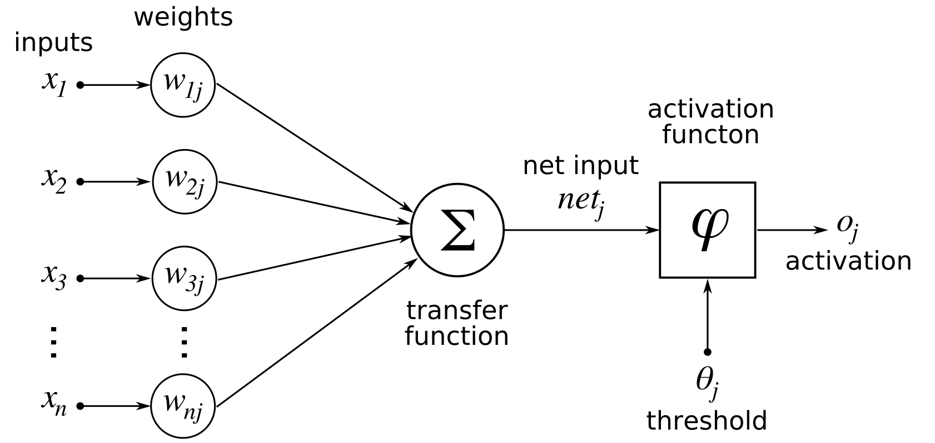
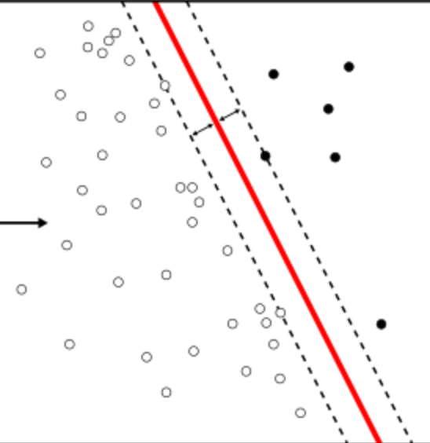
Perceptron
e = xW.
LearningApi/PerceptronLearning.cs at f713a28984e8f3115952c54cd9d60d53faa76ffe · UniversityOfAppliedSciencesFrankfurt/LearningApi (github.com)

Slide 7
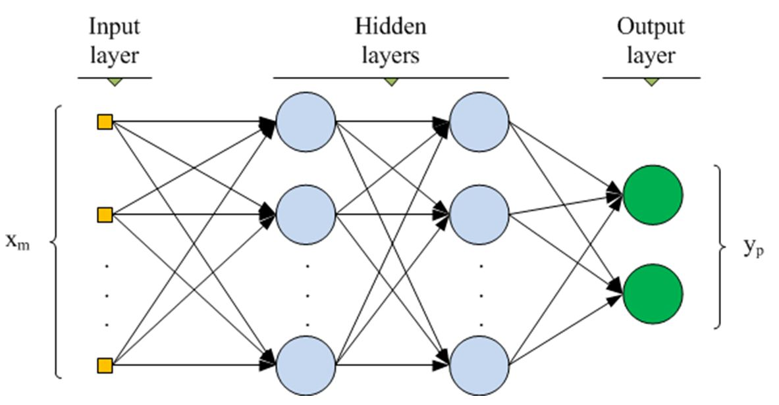
Multilayer ANN
www.cs.us.es/~fsancho/?e=135

Slide 8
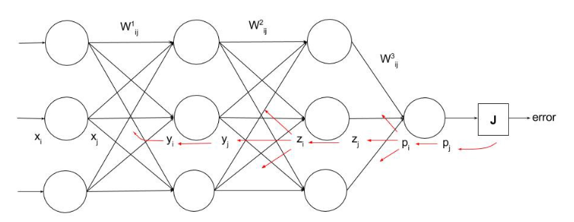
Backpropagation
(1) What is backpropagation really doing? | Chapter 3, Deep learning - YouTube
https://ayearofai.com/rohan-lenny-1-neural-networks-the-backpropagation-algorithm-explained-abf4609d4f9d

Slide 9
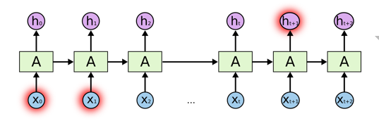
RNN
https://colah.github.io/posts/2015-08-Understanding-LSTMs

Slide 10
NEOCORTEX
Learning from brain

Slide 11

Brain
Neocortex
(rational)
Limbic
(emotional)
Reptilian
(instinctual)
http://siimland.com/what-to-feed-your-neocortex-to-boost-brain-power/
https://www.shutterstock.com/video/clip-540940-stock-footage--d-render-xray-style-image-of-the-human-brain-hd.html

Slide 12

Neuron

Slide 13
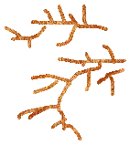
Neuron

Slide 14
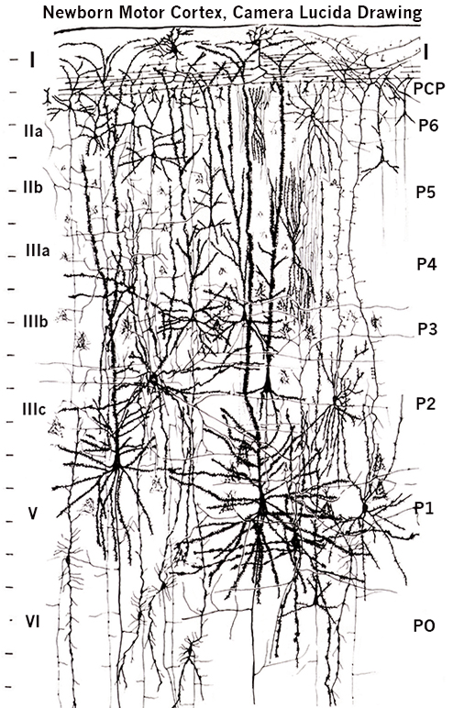
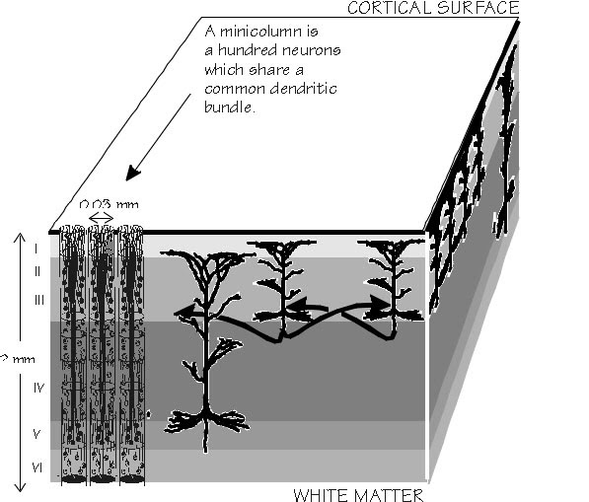
Layers and columns in neocortex
by Santiago Ramón y Cajal (1852-1934)
https://academic.oup.com/brain/article/125/5/935/328135

Slide 15
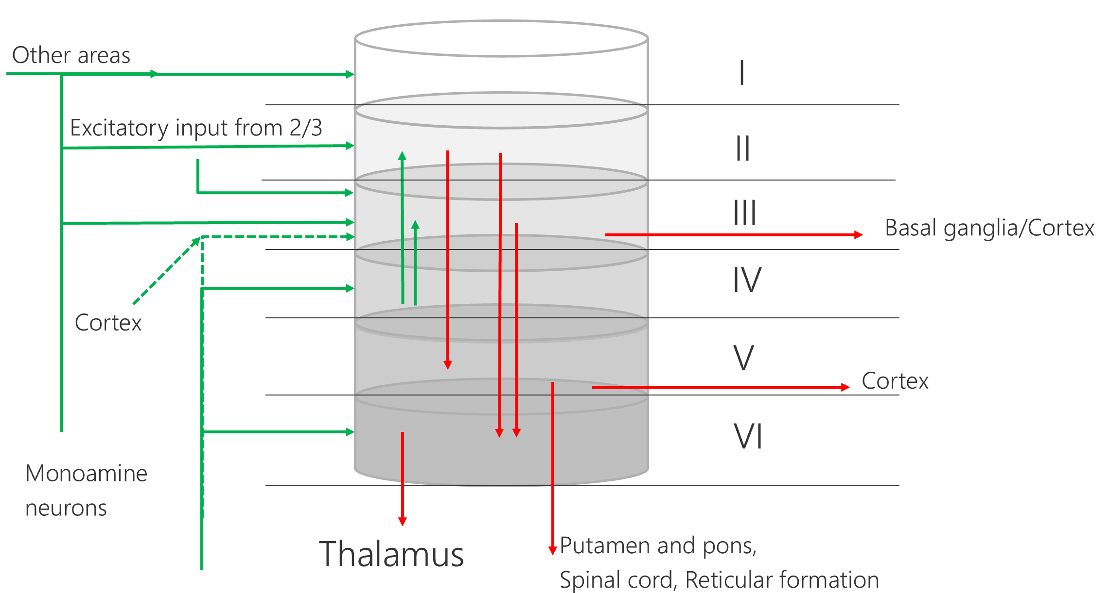
Model of a cortical column

Slide 16
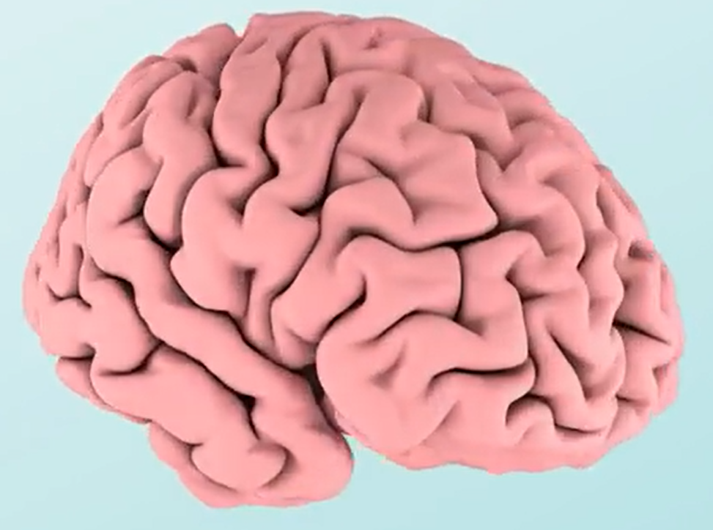

Layers and columns in neocortex

Slide 17
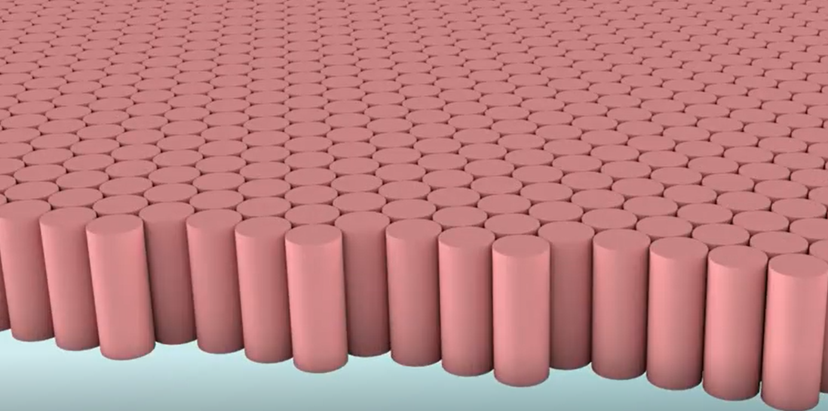
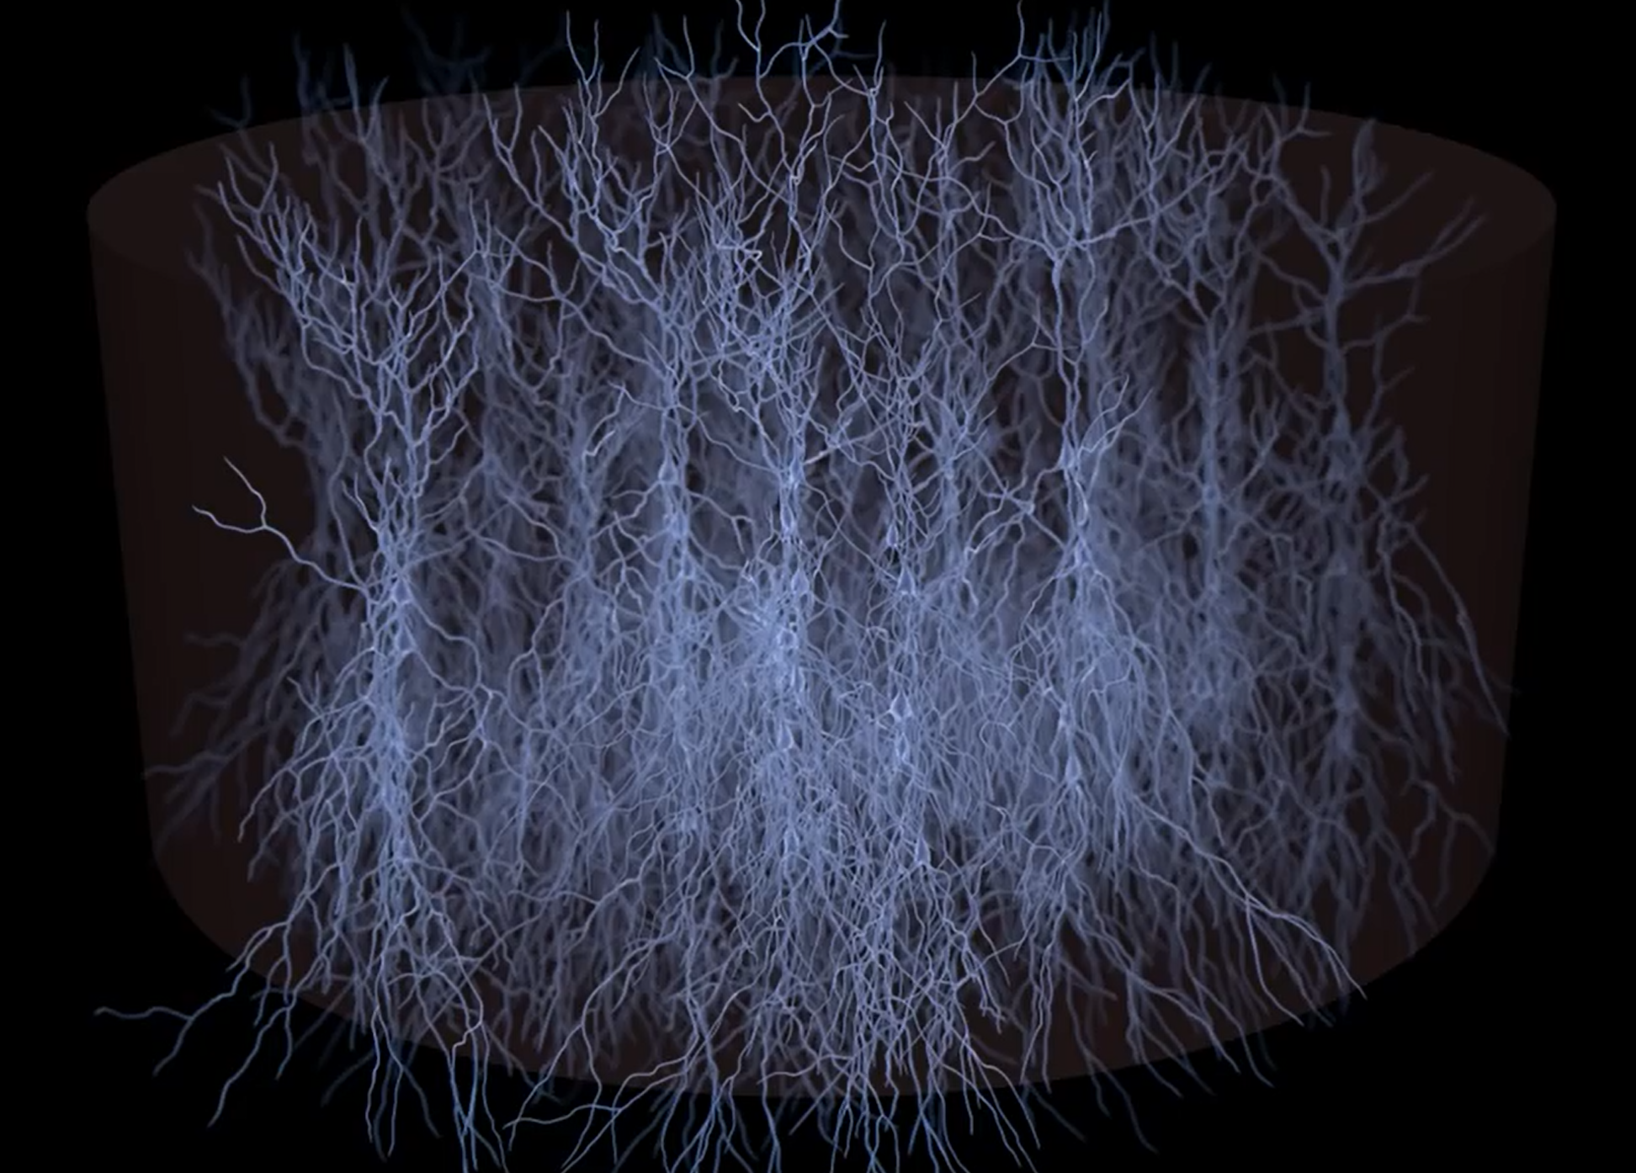
Cortical column with mini-columns
Video

Slide 18
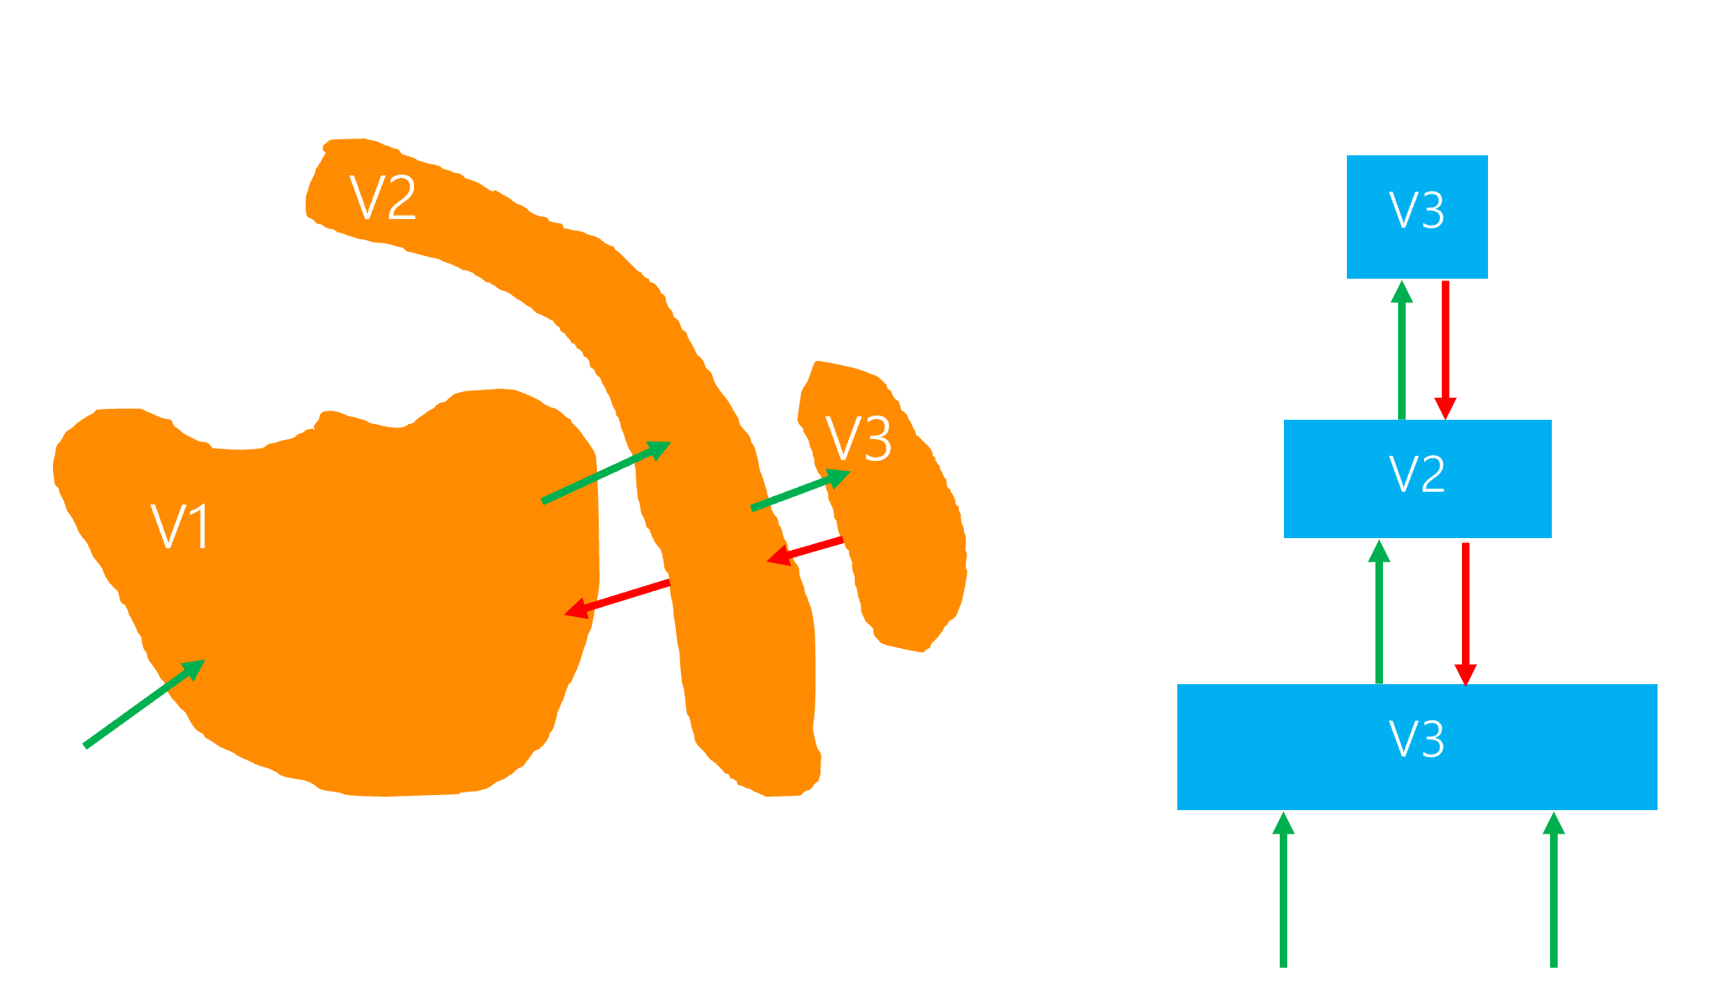
Hierarchical Semantic Layers

Slide 19
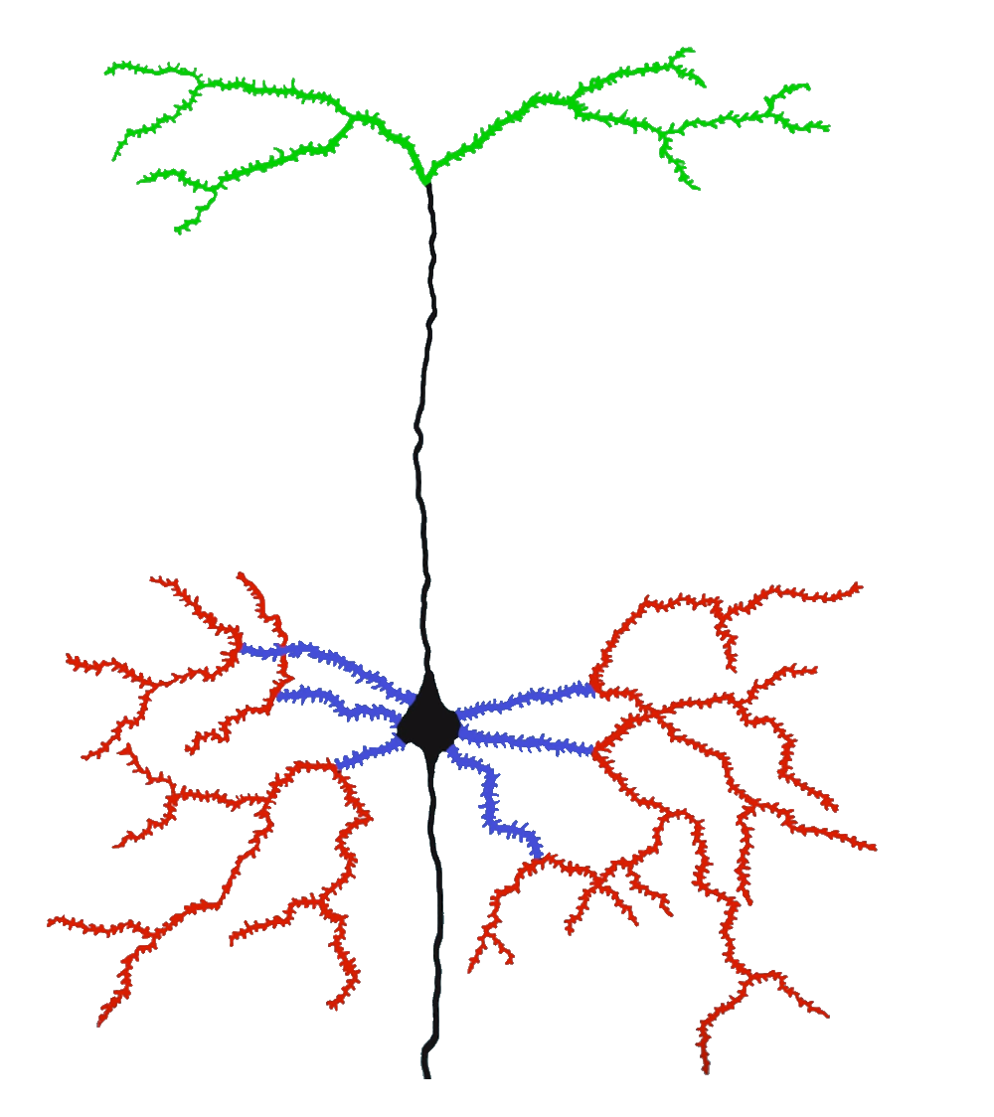
Hierarchical Temporal Memory Cortical Algorithm
Inspired by Neocortex
Different model of artifficial neuron
Dynamic Synapse grow
Inhibition
Boosting (homeostatic elasticity)
Two algorithms
Spatial Pooler
Temporal Memory
Feedback (apical)
Context (distal)
Feedforward (proximal)

Slide 20
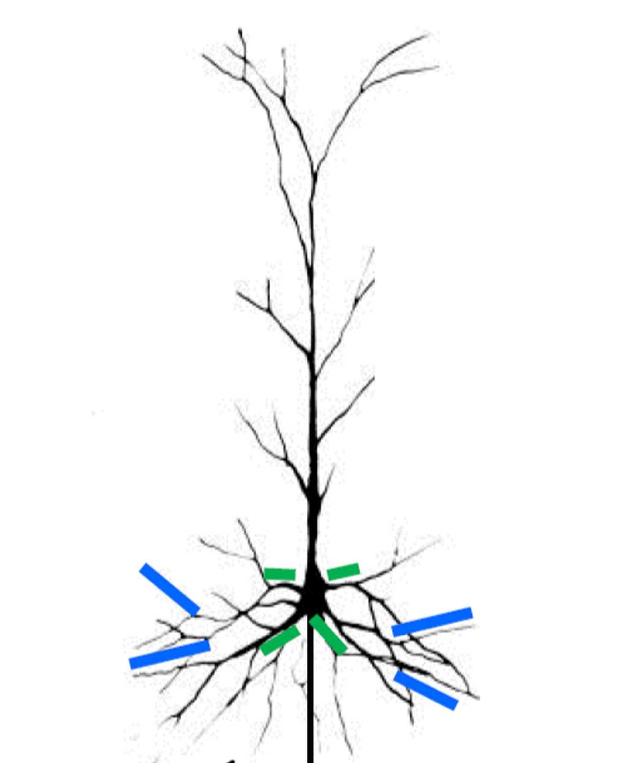
Neural Cell Model
Postsynaptic cell
Owner of the segment
Distal Dendrite Segment
Presynaptic cell
Receptor Synapses

Slide 21
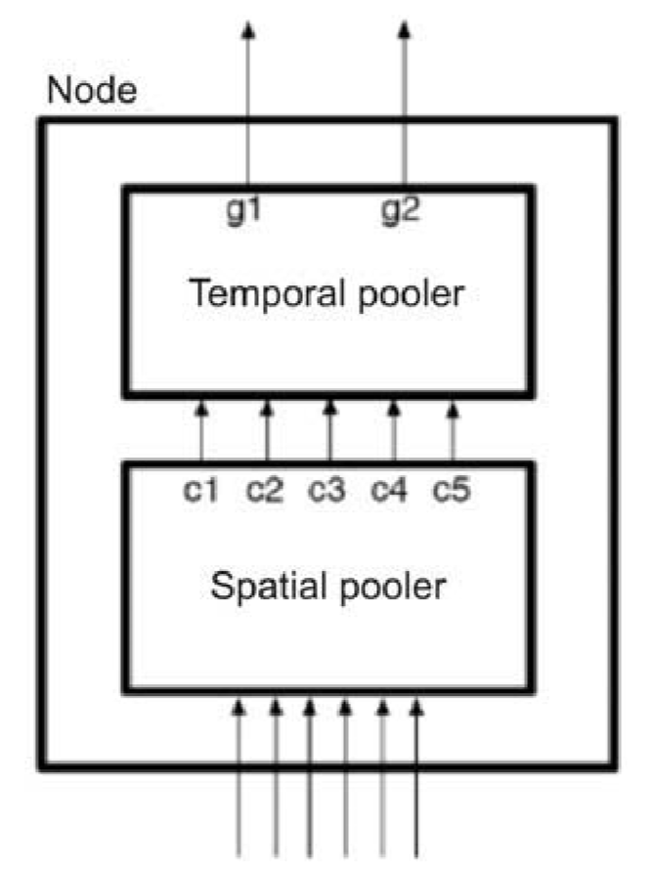
HTM CLA two algorithms
Spatial Pooler
Temporal Memory (Temporal Pooler is the old name)
Encoder

Slide 22
A Cortical Column with SP and TM
Mini-columns
column
Temporal Memory
Spatial Pooler
Sensory input
0
0
0
1
1
1
0
1

Slide 23
SDR Sparse Distributed Representation

Slide 24
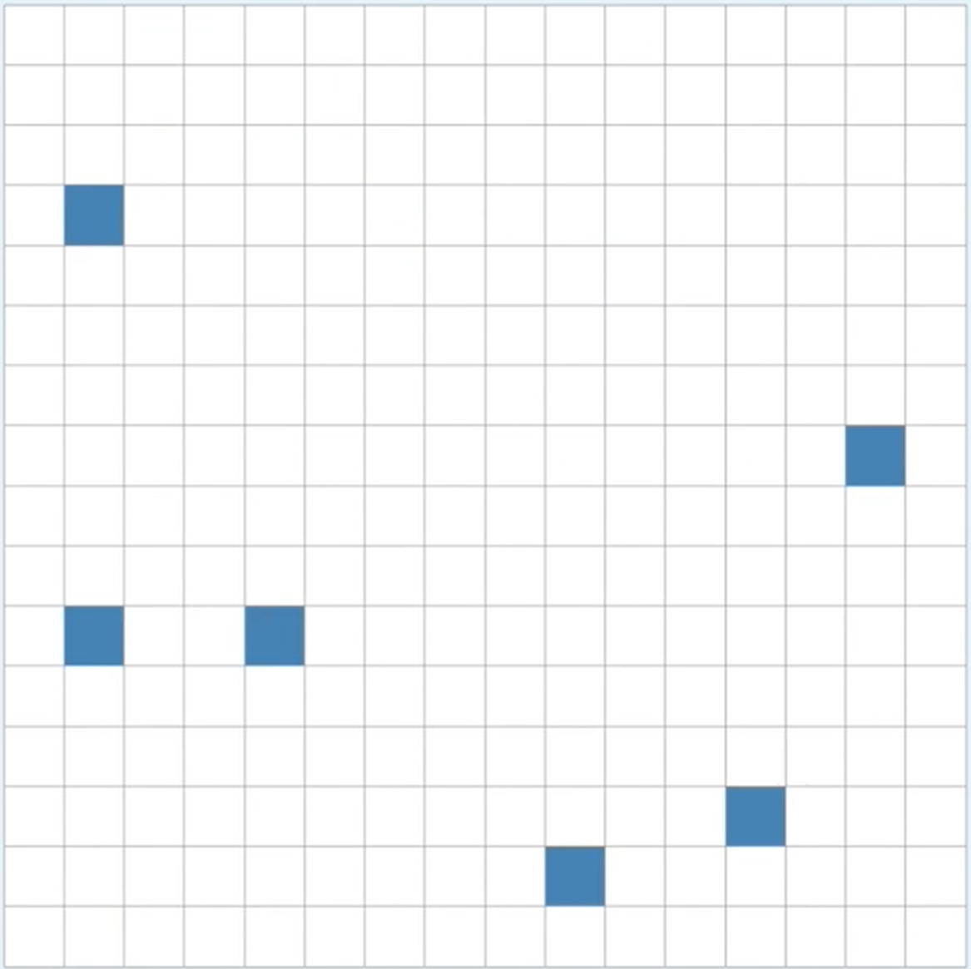
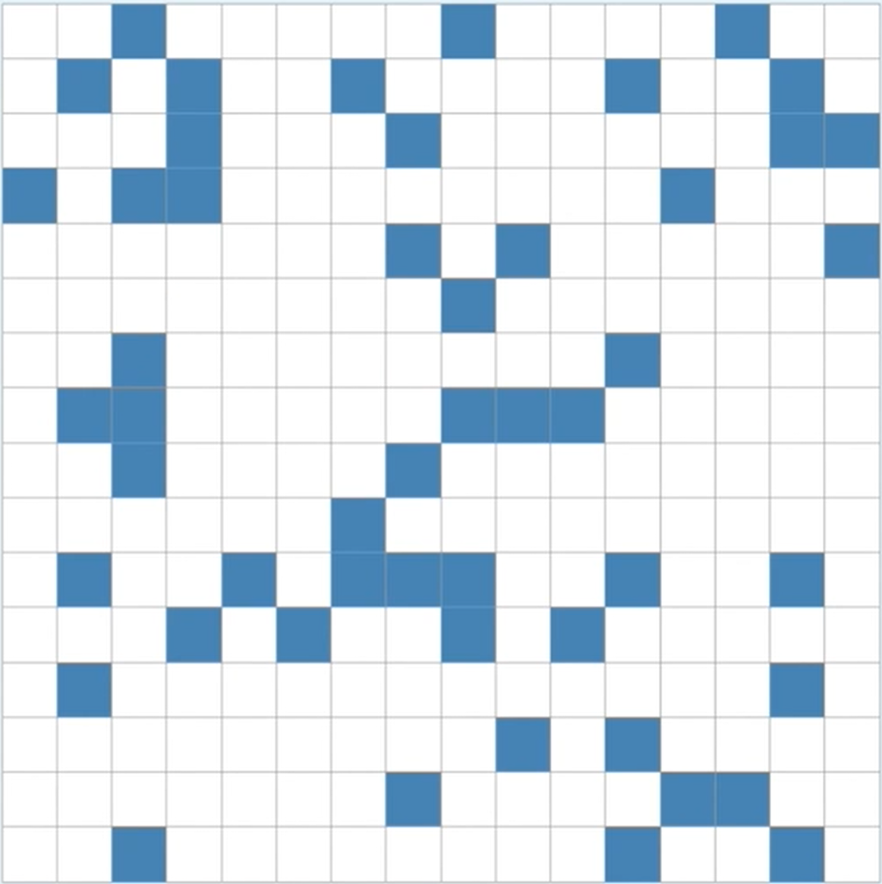
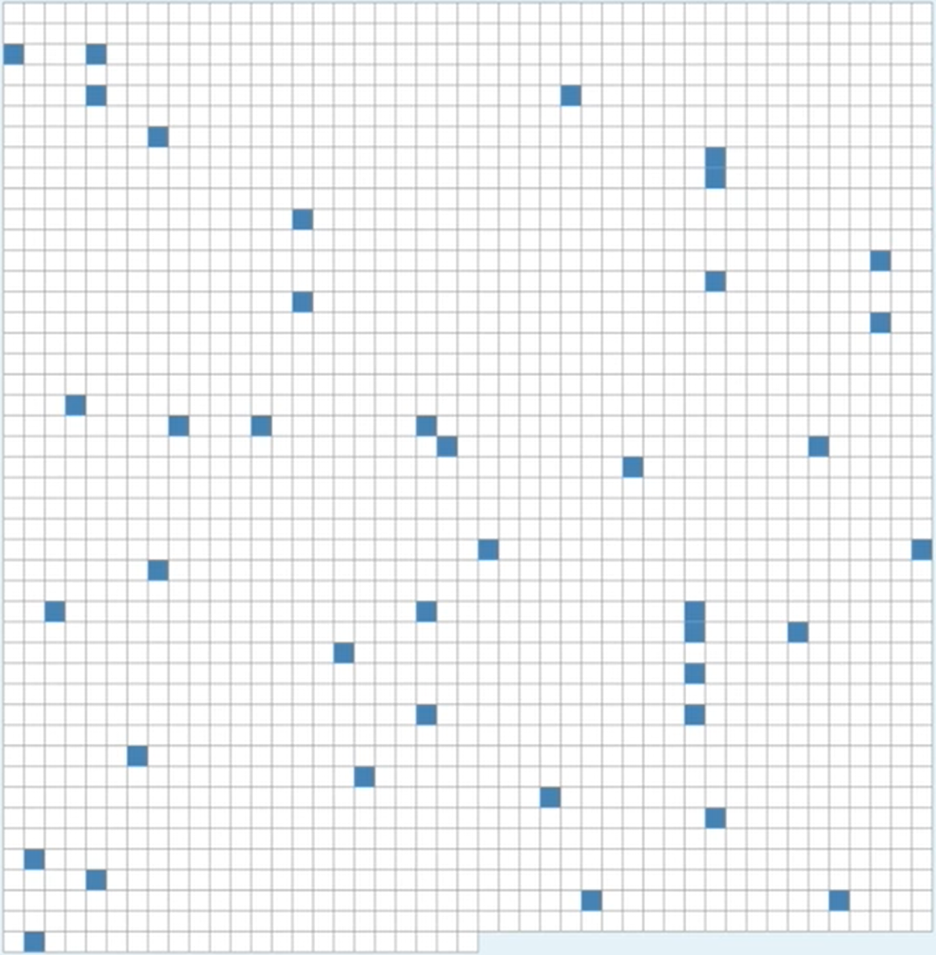
What is SDR?
Computers store information in “dense” representations.
Small number of bits
Int[10], char[1024],..
All bits are always set.
Brain stores information in a sparse form
Large number of bits
Only 2% used
0100000000000000000000010000000000000000000000000000000000000000010000..........01000 0000000010000000000000010000000000000000000000000010000000000000010000..........00000
https://www.youtube.com/watch?v=HLuRQKzYbb8&list=PL3yXMgtrZmDrotym3fyz_Oi06ZzFzpA_P

Slide 25

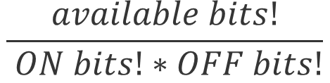
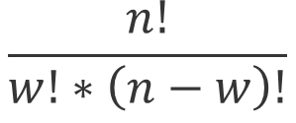
Capacity and Density of SDR
n = 16 w = 0 d = 0 c = 1
n = 16 w = 1 d =0.0625 c = 16
n = 16 w = 2 d =0.125 c = 120
n = 256 w = 6 d =0.0234 c =368532892176
n = 256 w = 51 d =0.192 c ~ 2034388346E45
n = 2048 w = 40 d =0.0195 c ~ 2371E81
$$\frac{available bits!}{ ON bits!∗OFF bits!}$$
$$\frac{n!}{w!∗\left(n−w\right)!}$$

Slide 26
NeocortexApi
https://github.com/ddobric/neocortexapi

Slide 27
ENCODER

Slide 28
What is an encoder?
HTM systems require data input in the form of Sparse Distributed Representations (SDRs)
SDR = Sparse Date Representation
An SDR is a large array of bits of which most are zeros and a few are ones.
First step of using an HTM system is to convert a data source into an SDR
https://pdfs.semanticscholar.org/1455/2052a0ee729539298e4f8eb42292c0eb1622.pdf

Slide 29
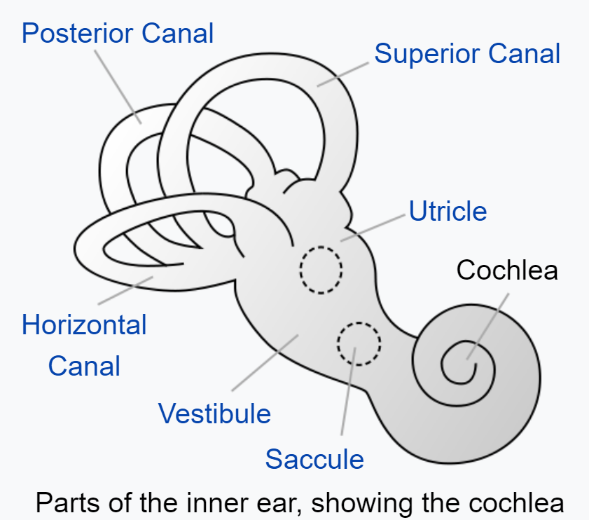
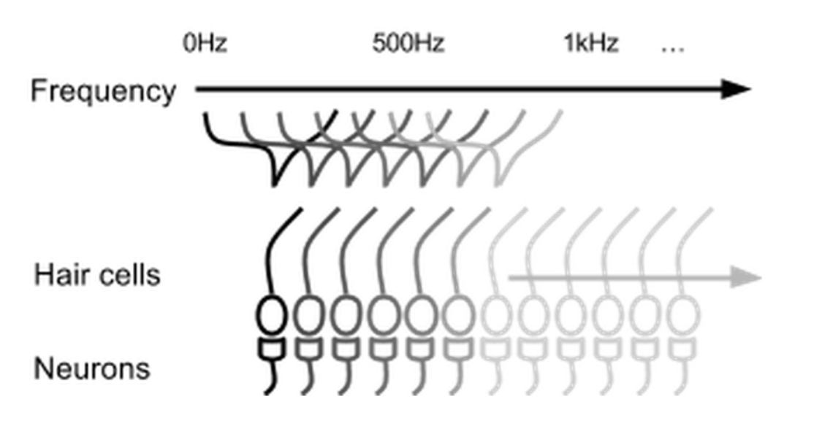
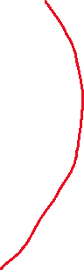
Parts of inner ear - Cochlea
Cochlear hair cells stimulate a set of neurons based on the frequency of the sound.

Slide 30
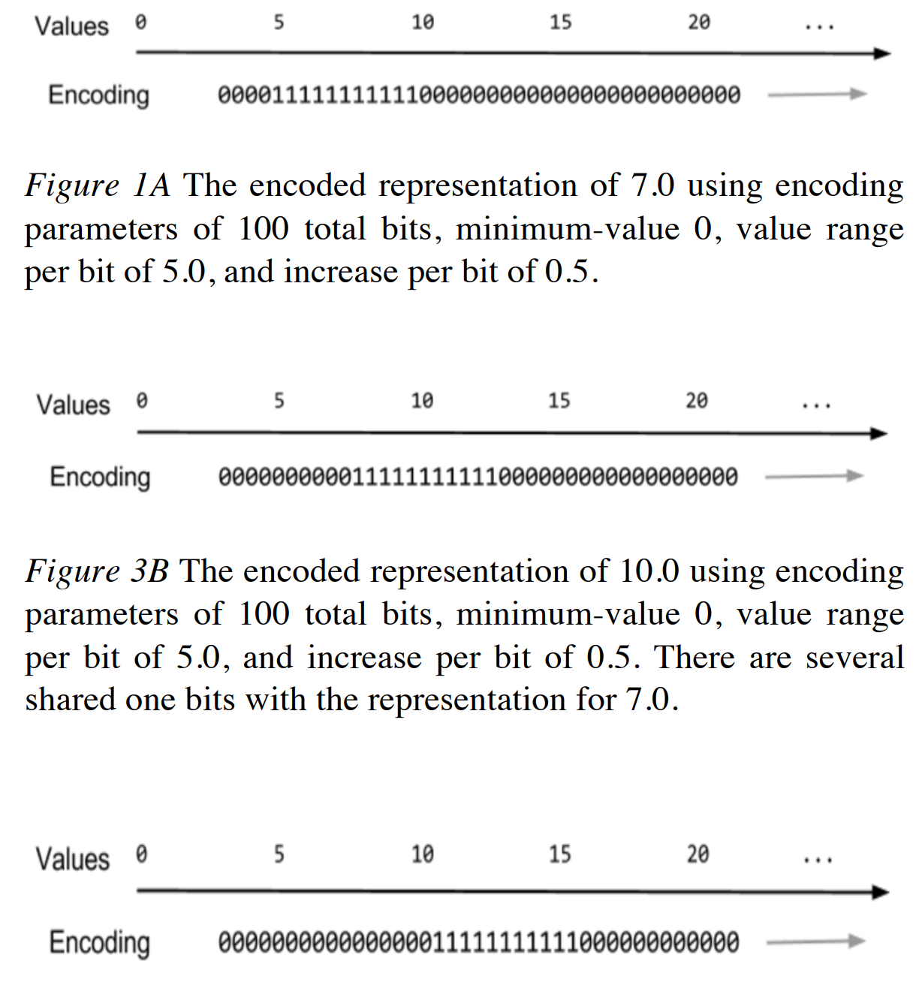
Encoding of scalar values

Slide 31
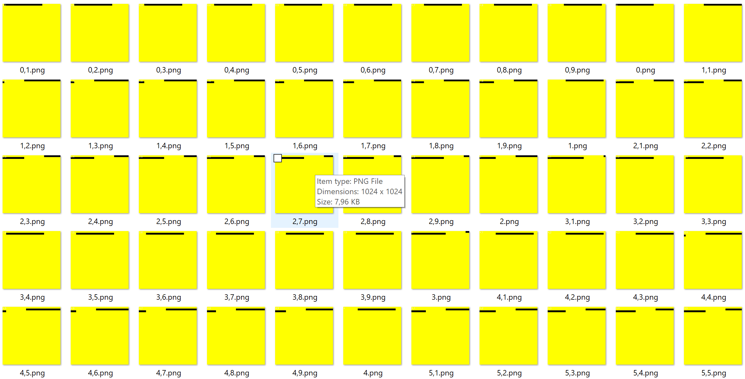
Example: Encoding of scalar values

Slide 32
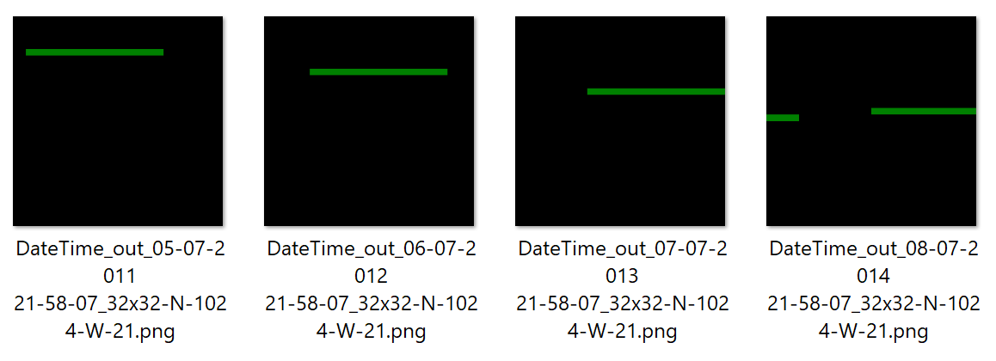
DateTime encoder

Slide 33

Definitions

Slide 34
Using encoder
ScalarEncoder encoder = new ScalarEncoder(new Dictionary<string, object>()
{
{ "W", 21},
{ "N", 1024},
{ "Radius", -1.0},
{ "MinVal", 0.0},
{ "MaxVal", 100.0 },
{ "Periodic", false},
{ "Name", "scalar"},
{ "ClipInput", false},
});
var result = encoder.Encode(i);
int[,] twoDimenArray = ArrayUtils.Make2DArray<int>(result, (int)Math.Sqrt(result.Length), (int)Math.Sqrt(result.Length));
var twoDimArray = ArrayUtils.Transpose(twoDimenArray);
NeoCortexUtils.DrawBitmap(twoDimArray, 1024, 1024, $"{outFolder}\\{i}.png", Color.Yellow, Color.Black, text:i.ToString());

Slide 35
SPATIAL POOLER

Slide 36

What is the Spatial Pooler?
It creates the SDR code of the given input
:)

Slide 37
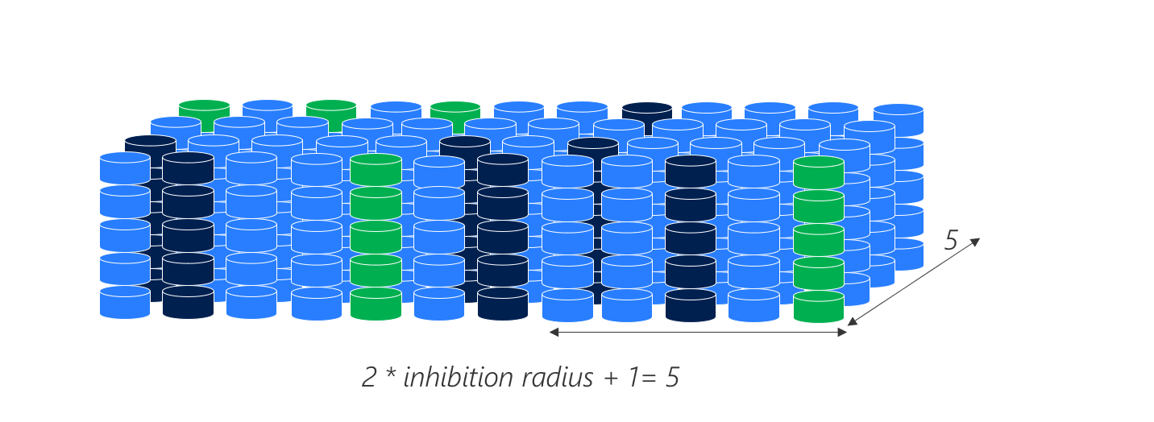
3D representation of the column with mini-columns

Slide 38
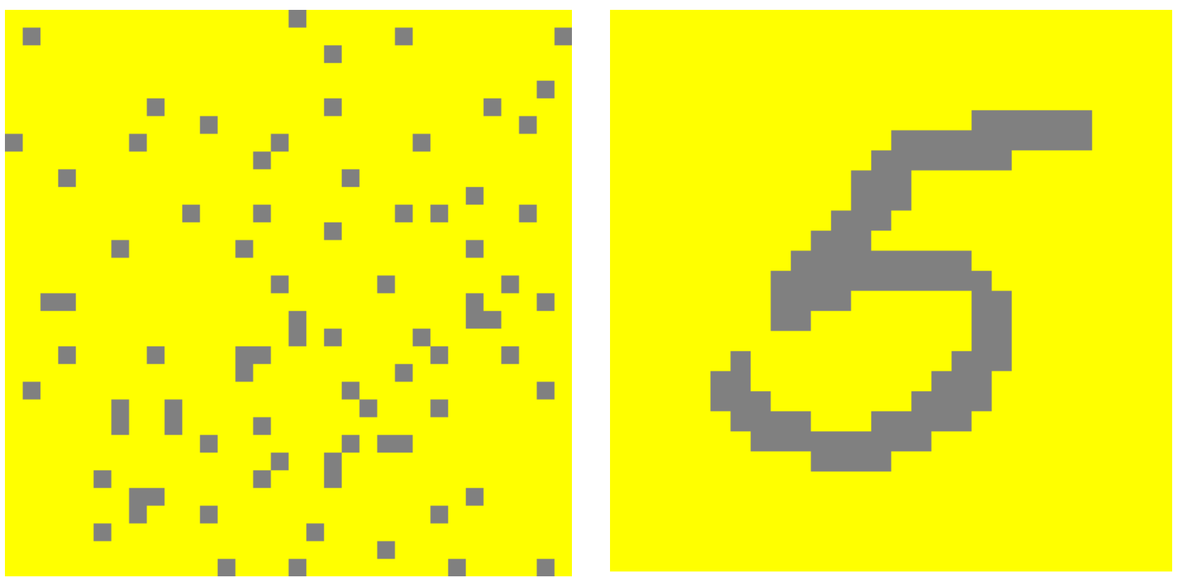
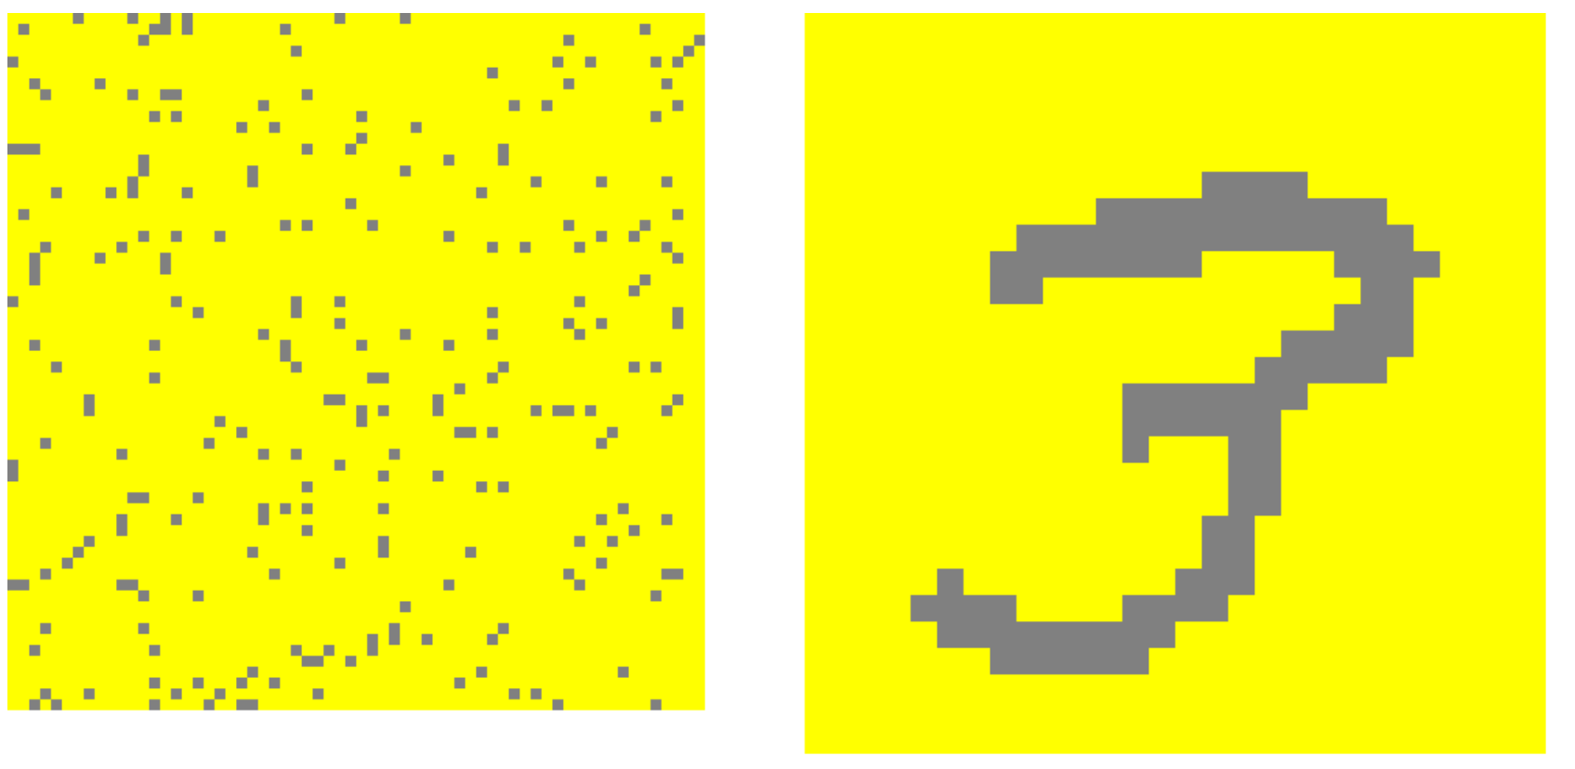
MNIST image of digits
SDR code of ‘5’
input
SDR code of ‘3’
input

Slide 39
Potential Radius
span
0
0
0
0
0
0
0
1
1
1
0
1
Receptive Fiield
(RF)

Slide 40
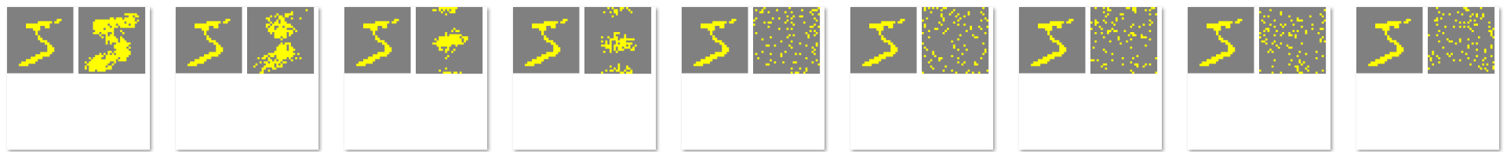
Inhibition Radius
Internally recalculated value in every cycle.
Global Inhibition Algorithm: i=max(columnDimensions)
Inhibition in all columns space
Local Inhibition
Inhibition in neighborhod of the calculating mini-column
10%
90%

Slide 41
Configuration
var htmConfig = new HtmConfig()
{
InputDimensions = new int[] { 5 },
ColumnDimensions = new int[] { 5 },
PotentialRadius = 5,
PotentialPct = 0.5,
GlobalInhibition = false,
LocalAreaDensity = -1.0,
NumActiveColumnsPerInhArea = 3.0,
StimulusThreshold = 0.0,
SynPermInactiveDec = 0.01,
SynPermActiveInc = 0.1,
SynPermConnected = 0.1,
MinPctOverlapDutyCycles = 0.1,
MinPctActiveDutyCycles = 0.1,
DutyCyclePeriod = 10,
MaxBoost = 10,
RandomGenSeed = 42,
Random = new ThreadSafeRandom(42),
};

Slide 42
Do not use this config!
public void SpatialSequenceLearningExperiment()
{
var parameters = GetDefaultParams();
parameters.Set(KEY.POTENTIAL_RADIUS, 64 * 64);
parameters.Set(KEY.POTENTIAL_PCT, 1.0);
parameters.Set(KEY.GLOBAL_INHIBITION, false);
parameters.Set(KEY.STIMULUS_THRESHOLD, 0.5);
parameters.Set(KEY.INHIBITION_RADIUS, (int)0.25 * 64 * 64);
parameters.Set(KEY.LOCAL_AREA_DENSITY, -1);
parameters.Set(KEY.NUM_ACTIVE_COLUMNS_PER_INH_AREA, 0.1 * 64 * 64);
parameters.Set(KEY.DUTY_CYCLE_PERIOD, 1000000);
parameters.Set(KEY.MAX_BOOST, 5);
parameters.setInputDimensions(new int[] { 32, 32 });
parameters.setColumnDimensions(new int[] { 64, 64 });
parameters.setNumActiveColumnsPerInhArea(0.02 * 64 * 64);
var sp = new SpatialPooler();
var mem = new Connections();
double[] inputSequence = new double[] { 1.0, 2.0, 3.0, 4.0, 5.0, 6.0, 7.0 };
var inputVectors = GetEncodedSequence(inputSequence, 0.0, 100.0);
parameters.apply(mem);
sp.init(mem);
. . .
}

Slide 43
Using Spatial Pooler
HtmConfig htmConfig = SetupHtmConfigParameters();
mem = new Connections(htmConfig);
sp = new SpatialPoolerMT(); // Fast version. Uses all CPUs/Cores //sp = new SpatialPooler(); // Single-Threaded. Slower. Good for debugging
sp.Init(mem);

Slide 44
Using SpatialPooler
Set the configuration
public void SpatialSequenceLearningExperiment()
{
HtmConfig cfg = new HtmConfig(new int[] { inputBits }, new int[] { numColumns }){...}
var mem = new Connections(cfg);
sp.init(mem);
foreach (var inputVector in inputVectors)
{
for (int i = 0; i < 3; i++)
{
var activeArray = sp.Compute(inputVector, true) as int[];
var activeCols = ArrayUtils.IndexWhere(activeArray, (el) => el == 1);
var str = Helpers.StringifyVector(activeCols);
Debug.WriteLine(str);
}
}
}
Training loop for all input patterns (vectors)
Train (learn) every input 3 times. This is usually enough to learn the input. After 3 cycles, the input is encoded to a stable SDR.
Init SpatialPooler
This is learning line of code. Second arg true, means active learning. If set on false, no learning is active. Already learned mini-columns will be activated.
We get here sparse set of indices of active mini-columns.
https://github.com/ddobric/neocortexapi/blob/master/source/Samples/NeoCortexApiSample/SpatialPatternLearning.cs

Slide 45
SpatialPooler Compute() method
var activeIndicies = sp.Compute(inputVector, true) as int[];
int[] activeArray = new int[actiColumnLength];
sp.Compute(inputVector, activeArray, true);
Debug.WriteLine(Helpers.StringifyVector(activeArray));
Debug.WriteLine(Helpers.StringifyVector(activeIndicies));
activeIndicies
2,3,..
0,0,1,1,0,0..
activeArray

Slide 46
Examples for Spatial Pooler
All tests are implemented in project: UnitTestsProject
SP Tests:
Experiments: SpatialPoolerResearchTests
UnitTests: SpatialPoolerTests
Sample:
SpatialPatternLearning

Slide 47
TEMPORAL MEMORY

Slide 48
Examples for Temporal Memory
All tests are implemented in project: UnitTestsProject
Temporal Memory Tests:
Experiments: NetworkTests.cs
UnitTests: TemporalMemoryTests.cs
Sample: MultiSequenceLearning.cs

Slide 49
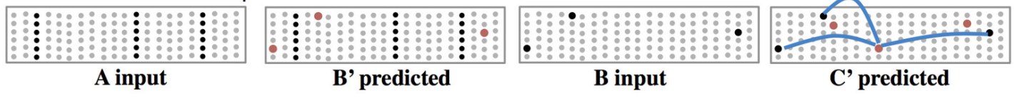
Layers Model & Sequence Memory

Slide 50
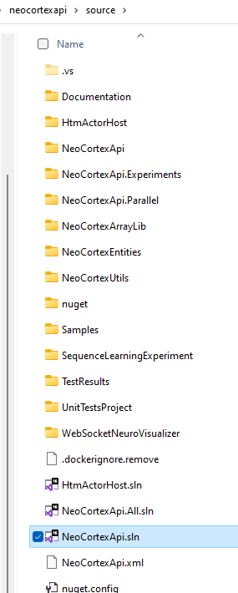
Exercise XII
Working with Spatial Pooler
Tutorial https://github.com/ddobric/neocortexapi/blob/master/source/Documentation/tutorial.md
Getting started https://github.com/ddobric/neocortexapi/blob/master/source/Documentation/gettingStarted.md
Spatial pooler experiment example https://github.com/ddobric/neocortexapi/blob/master/source/Samples/NeoCortexApiSample/SpatialPatternLearning.cs
Working with Temporal Memory https://github.com/ddobric/neocortexapi/blob/master/source/Samples/NeoCortexApiSample/SequenceLearning.cs
Analysing SDRs neocortexapi/ColumnActivity.md at master · ddobric/neocortexapi (github.com)
See references (last slide)

Slide 51
Average Span of connected synapses
Min = {1}
Max = {8}
Average = (8-1)/2=3.5
MinX =0, MinY=0
MaxX = 4, MaxY=1
Average((4-0),(1-0))=
(4-1)/2=1.5
1
1
0
0
0
0
0
0
0
1
0
Sensory input
0
0
1
0
0
1
0
0
0
1
0
0
1
0
0
1
0
0
0
1
0
0
4
9

Slide 52
Inhibition
Prevents over-activation (overfitting)
Ensure sparsity
Calculates InhibitionRadius
InhibitionRadius defines neighbourhood
Inhibiting mini-columns inside inhibition area (neighbourhood)
5
2 * inhibition radius + 1= 5

Slide 53
Global Inhibition
InhibitionRadius is set over the entire column area.

Slide 54

Local Inhibition example
Inhibition Radius = 2, threshold = 0, density=0.5
act = (int)(0.5 + density * neighborhood.Length);
Two higher than 1.0
(0) Winners={}, act=2
1.0
2.0
7.0
0.0
3.0
4.0
16
1.0
1.5
1.7
One higher than 2
(1) Winners={1}, act=2
1.0
2.0
7.0
0.0
3.0
4.0
16
1.0
1.5
1.7
No higher than 7.0
(2) Winners={1,2}, act=3
1.0
2.0
7.0
0.0
3.0
4.0
16
1.0
1.5
1.7
Four higher than 0.0
(3) Winners={1,2}, act=3
1.0
2.0
7.0
0.0
3.0
4.0
16
1.0
1.5
1.7
Three higher than 0.0
(4) Winners={1,2}, act=3
1.0
2.0
7.0
0.0
3.0
4.0
16
1.0
1.5
1.7

Slide 55
Local Inhibition example continue
Inhibition Radius = 2, threshold = 0, density=0.5
act = (int)(0.5 + density * neighborhood.Length);
One with higher than 4.0
(5) Winners={1,2,5}, act=3
1.0
2.0
7.0
0.0
3.0
4.0
16
1.0
1.5
1.7
No higher than 16
(6) Winners={1,2,5,6},act=3
1.0
2.0
7.0
0.0
3.0
4.0
16
1.0
1.5
1.7
Four higher than 1.0
(7) Winners={1,2,5,6},act=3
1.0
2.0
7.0
0.0
3.0
4.0
16
1.0
1.5
1.7
Two higher than 1.5
(8) Winners={1,2,5,6},act=3
1.0
2.0
7.0
0.0
3.0
4.0
16
1.0
1.5
1.7
One higher than 1.7
(9) Winners={1,2,5,6,9},act=3
1.0
2.0
7.0
0.0
3.0
4.0
16
1.0
1.5
1.7

Slide 56
Local Inhibition – Top view on columns

Slide 57
Column Global Inhibition algorithm
Num of columns = 10
Density = 20% => 2 columns can be inhibited.
Chose 2 columns with highest overlap: o(k)
o(0) = 4, o(1) = 0, o(2) = 3 => active columns = {0,2}
c0
c1
c9
0
0
0
0
0
0
0
1
1
1
0
1
1
0
0
0
0
0
1
0

Slide 58
Column Local Inhibition algorithm
Num of columns = 10
Inhibition radius = 2. Means 5 columns can be reached.
Density = 50% =>50% of 5 reached columns can be inhibited =>2-5
Now calculate N: num of cols with bigger overlap then focusing col.
Focus col=0, span 0,1,2=3, 50% of (3)+0.5 = (int)2, N=2 {1,2}/[2,7] (-)
Focus col=1, span 0,1,2,3=4, 50% of (3)+0.5 = (int)2, N=1 {1}/[7]<2 (+)
Focus col=2,span 0,1,2,4=4, 50% of (2)+0.5 = (int)3, N=0 {2,7}<2 (+)
1 2 7 0 3 4 16 1 1.5 1.7

Slide 59
MATH C#
---------------------------------------------------------------
x1 = {1.2, 2.8, 3.5} | var x1 = new double[] {1.2, 2.8, 3.5}
x2 = {1.2, 2.5, 2.9} | var x1 = new double[] {1.2, 2.5, 2.9}
xN
----------------------------------------------------------------
double[][] inputVectors = new double[N][];
inputVectors[0] = x1;
inputVectors[1] = x2;
...
inputVectors[N] = xN;
--- Another way ------------
List<double[]> inputVectors = List<double[]>();
inputVectors.Add(x1);
inputVectors.Add(x2);
..
inputVectors.Add(xN);

Slide 60
References
https://www.youtube.com/watch?v=Ub1fE-bAroA
https://en.wikipedia.org/wiki/Hierarchical_temporal_memory
https://www.youtube.com/watch?v=nBYddmFg4nQ
https://web.archive.org/web/20110714212402/http://www.numenta.com/htm-overview/education.php
Spatial Pooling Algorithm Details (numenta.com)

Slide 61
Publications
International Journal of Artificial Intelligence and Applications:
https://aircconline.com/abstract/ijaia/v11n4/11420ijaia07.html
10.5121/ijaia .2020.11407
AIS 2020 - 6th International Conference on Artificial Intelligence and Soft Computing, Helsinki
https://aircconline.com/csit/csit1006.pdf
10.5121/csit.2020.100605
Symposium on Pattern Recognition and Applications, Nov. 6 - 8, 2020 @ Rome
https://doi.org/10.1145/3393822.3432317
https://dl.acm.org/doi/10.1145/3393822.3432317
10.1145/3393822.3432317
ICPRAM Vienna 2021 (Award Winner Paper)
Improved HTM Spatial Pooler with Homeostatic Plasticity control
https://www.scitepress.org/PublicationsDetail.aspx?ID=fUz607CA/eU=&t=1
Improved HTM Spatial Pooler with Homeostatic Plasticity Control - ICPRAM 2021 (insticc.org) 10.5220/0010314200980106
Springer Nature Computer Science Journal
https://www.springer.com/journal/42979/updates/17257234

Slide 62

Thank You

